Slide 1
MSCA 31008 Boot Camp Review
Week 2

Slide 2
Week 2 Agenda
Binomial Probability
Normal Distribution
Sampling Distribution of the Mean
Difference between the Means

Slide 3
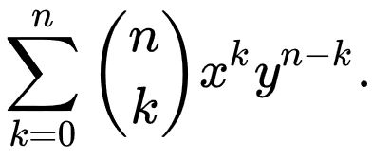
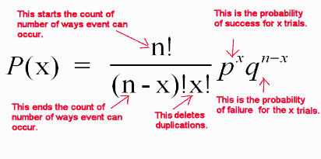
Binomial Each trial can result in one of the same two possible outcomes, success (S) or Failure (F). The n over x is the combination to be calculated

Slide 4
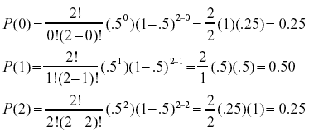
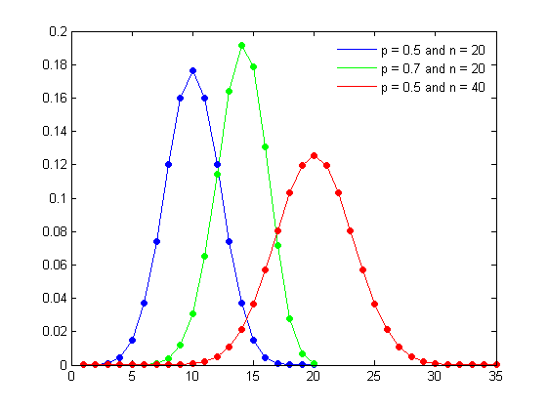
Binomial Distribution

Slide 5
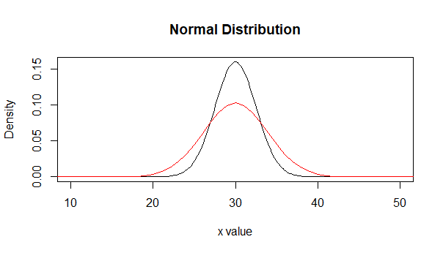
Normal Distribution

Slide 6
Normalizing Data – Z Score
When your data is in different scales you can normalize it for accurate analysis
Z = (X-μ)/σ
100, 200, 150, 200, 300, 600, 450, 300, 250, 275
= 282.5
= 147.22
(100−282.5)/147.22 = −1.24
This is 1.24 standard deviations from the mean

Slide 7
Sampling Distribution of the Mean
Central Limit Theorem
Assuming your data has a measurable mean and some variance, the mean of samples taken from that data will eventually form a distribution that approaches normal, depending on how large your sample is and how many samples you pull.
This is true, regardless of the shape of your original data.
These samples will have a mean that is the same as the mean of the data and the variance of σ²/N
Sqrt(σ²/N ) = σ/sqrt(N) = Standard Error of the Sampling Distribution of the Mean

Slide 8

Difference between the Means
Sampling distribution of the difference between the means:
μ_{Μ1-M2} = M₁-M₂
Standard Error of the Difference between the Means
Please note that there is a PLUS sign

Slide 9
Standard Error of the Mean
Standard Error of the Mean is σ = σ/sqrt(N) and tells us how much variation there is in the sampling means
The more sampling you do the smaller the variability

